Slide 1
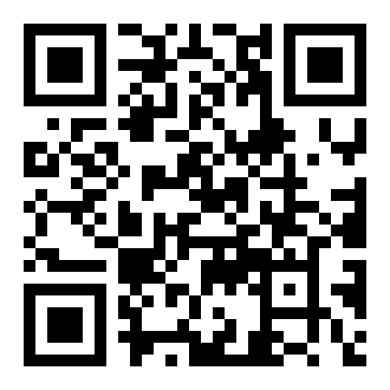
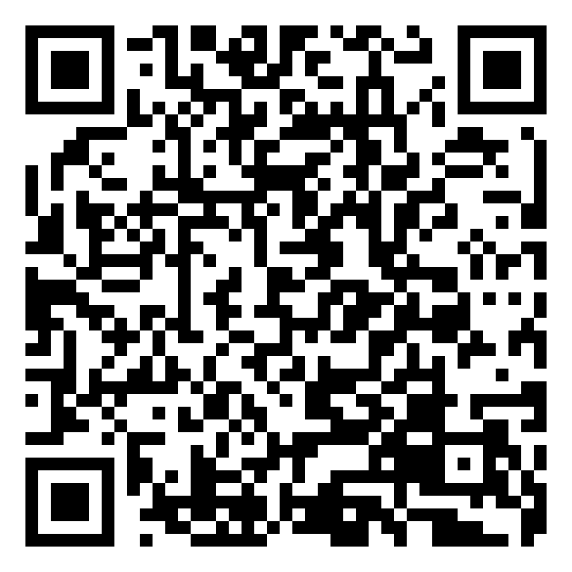
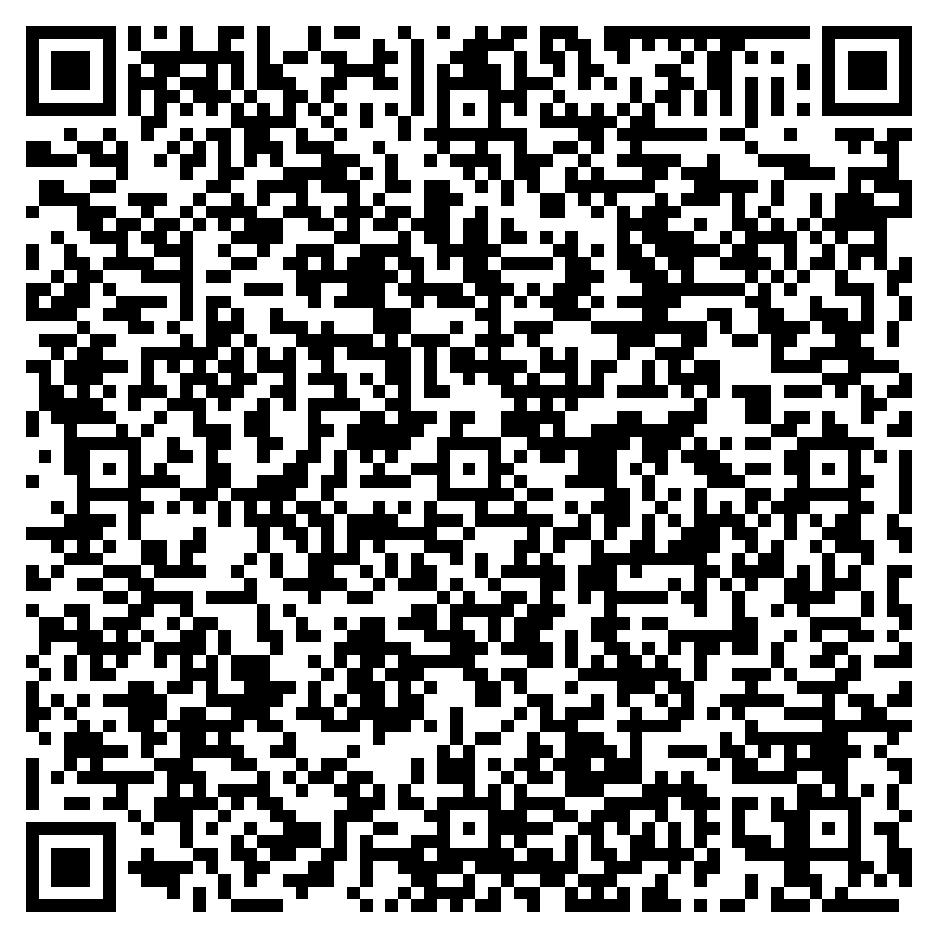
Go to the rwpoll.com or scan the QR code to get the app

Slide 2
TurningPoint
Interactive voting system
Franco Moreno

Slide 3
Agenda
Have a go with the handsets or wireless device
What’s new to you

Slide 4
How often do you use TurningPoint?
Never used it before
I’ve used it once or twice
I use it regularly
I’m in IT supporting it

Slide 5
Simple to Use. Powerful Impact.

Slide 6
Where have you travelled from?
Rank | Responses
1 | WOLVERHAMPTON
2 | 5.5HRS AWAY!
3 | CULLERCOATS
4 | DURHAM
5 | NEWCASTLE UNI
6 | Other
Values:
Value Matches: 0

Slide 7
Pedagogy
Website: TurningTechnologies.co.uk
Twitter: @turningtechuk
Blog: Scoop.it/t/turningtechuk

Slide 8
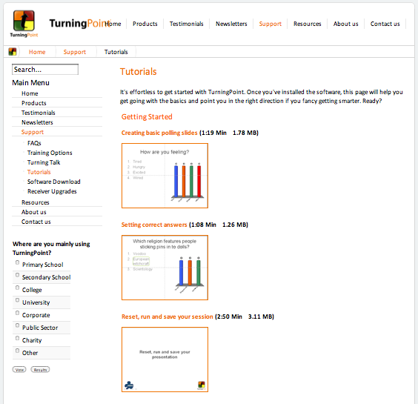
Online Community
www.turningtechnologies.co.uk
Notes:
Training sessions
Training sessions are available at half and full day
Support from Reivo

Slide 9
Thank you!
Visit
www.turningtechnologies.co.uk
for more information

